Slide 1
Personality Prediction Using Machine Learning
FINAL PRESENTATION
Thejas S Anujith.K

Slide 2
Recalling Everything we have done till midway
Firstly we did an exploratory data analysis to get the intuitive nature of our data set For pre-processing We binarized the type indicator to handle the classification easier Then we used NLTK and imported few tools like word_tokenize, WordNetLemmatizer etc to process the bulk. Essentially we turned all words into lowercase, lemmatized it and all of the URLs were removed. We also removed stopwords. Our dataset had information regarding the MBTI before each posts, so those strings were also removed for preventing cheating.

Slide 3
Then we used sklearn.feature_extraction module to use TfidfTransformer and CountVectorizer. All words with frequency less than 10% or more than 70% were removed because our reference papers used these exact frequency. After all these filtration, we got 790 words as features to implement our XGBoost models. A basic XGBoost model was implemented. The least accuracy we got was close to 64%

Slide 4
Work after Midway
To adjust our XGboost model we first manually tweaked the parameters such as learning rate, size/number of trees etc based on few methods suggested online and tried multiple variants. But we were unable to find any specific trend for improving it.
We learned that scikit-learn had GridSearchCV which would loop through predefined hyperparameters and fit our model. Then we ran another iteration using the optimal hyperparameters suggested by it. Our professor Subhankar Sir pointed out that percentage won’t be a good indicator for accuracy so we used a confusion matrix to visualize our result.

Slide 5
Results
GridSearchCV found that 0.2 learning rate and 200 trees were the best parameters
We then changed our model accordingly, ran the XGboost and then used confusion matrix on one of the indicators to visualize the result

Slide 6
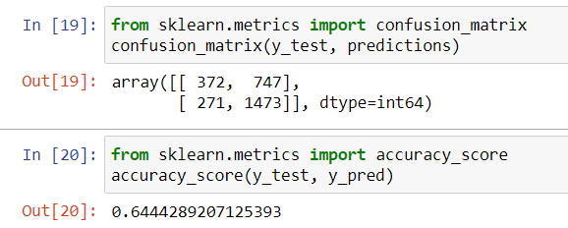
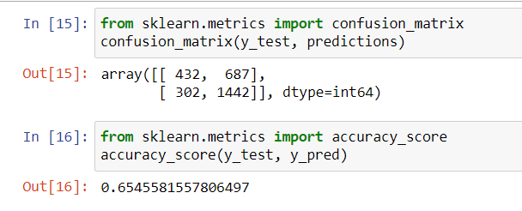
This was our first model’s results for our worst indicator
And this is our best result using the hyperparamters from GridSearchCV

Slide 7
Conclusion and shortcomings
While we did improve from our first models and was better than results shown in our second reference, accuracy for Judging (J) – Perceiving (P) wasn’t improved to the extend of our expectations.
This might have been due to the fact that, J-P had almost equal distribution (Our reference which used the same dataset also had low accuracy for J-P). Due to scarcity of large datasets of MBTI types with label, we were not able to try our model on other datasets. We also used the model to predict our personality from posts we made and compared to our self tested MBTI indicators. It had 75% accuracy but some sort of bias could have heavily influenced it. In the future we hope to try this model on new larger datasets

Slide 8
THANK YOU!

